Slide 1
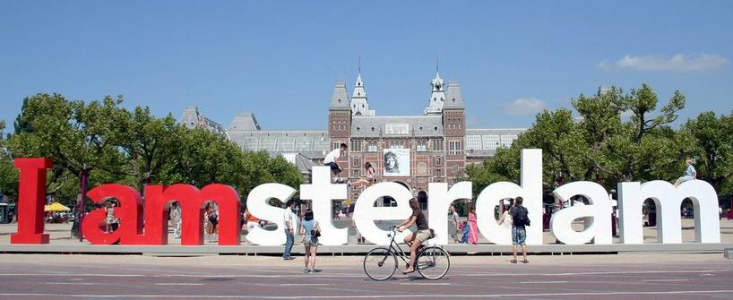
Amsterdam University of Applied Sciences Seminar Internationaliseren doe je samen; de docent maakt het verschil 4 juni 2015

Slide 2
Organisational chart Amsterdam University of Applied Sciences (AUAS) and the University of Amsterdam (UVA)

Slide 3
Faculties within the AUAS
Faculty of Digital Media & Creative Industry
International Business School
Faculty of Economics and Management
Marketing, Sales and Trade
Faculty of Education
Faculty of Health Professions
Management and Organisation
AUAS
Faculty of Social Work and Law
Finance and Accounting
Faculty of Sports and Nutrition
Faculty of Technology

Slide 4
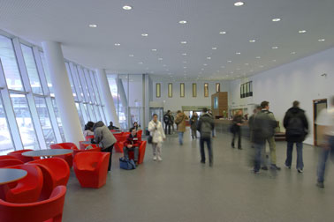
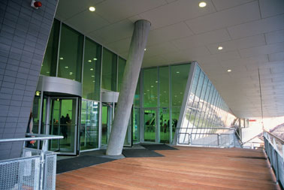
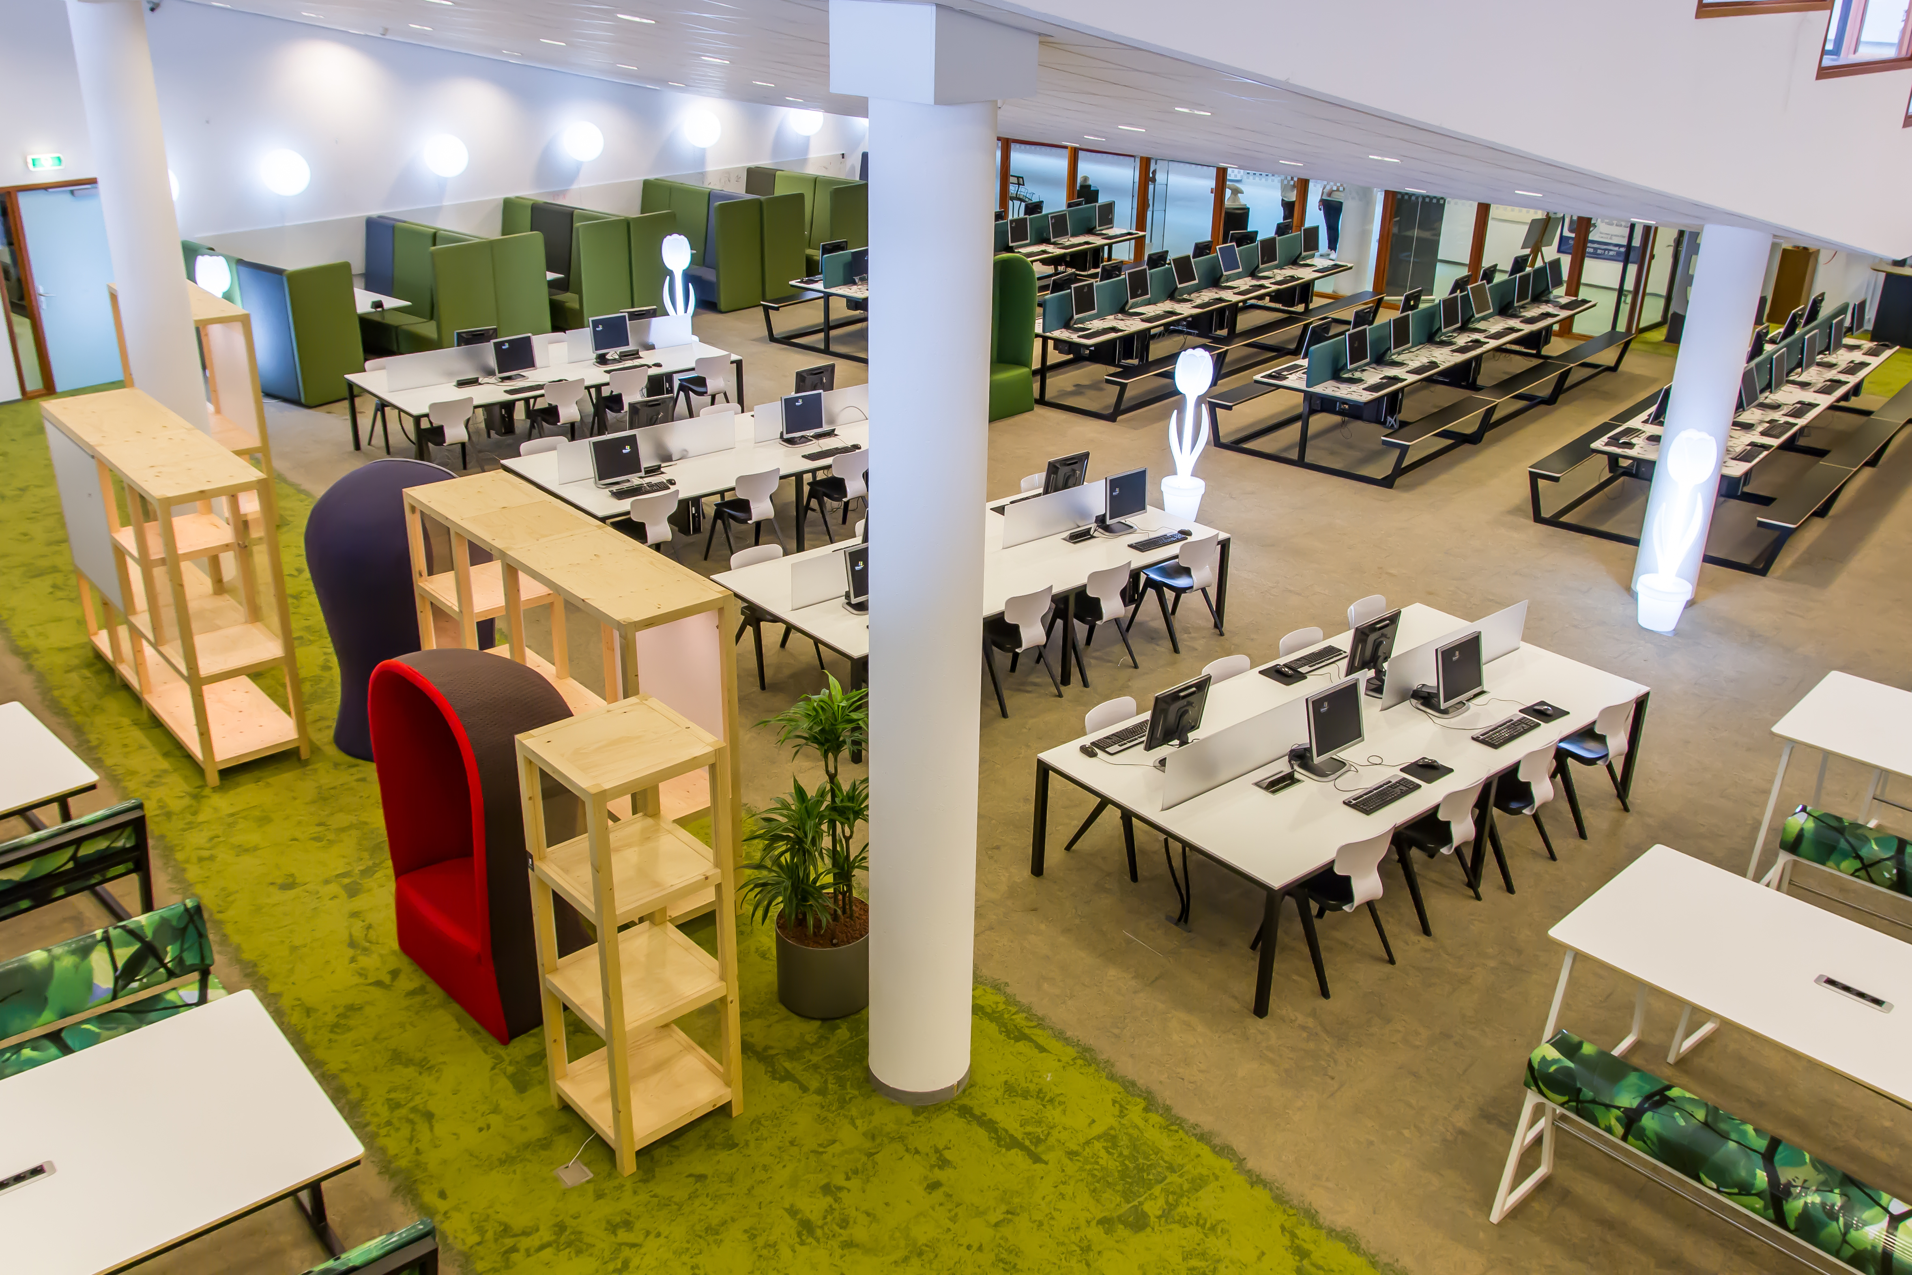
The Faculty of Economics and Management

Slide 5
Faculty of Economics & Management
Marketing Sales & Trade
Marketing (including Sports Marketing)
Johan Cruijff university
Finance & Accounting
Accountancy
Financial services management
Fiscal Law and Economy
Finance & control
Management & Organisation
Human Resource Management
Business Management Studies
International Business School
International Business and Management Studies
International Business and Languages

Slide 6
International Business School
3000 students
Staff 20% only foreign passports, 30% including double passports
Students 20% international excl exchange 450 incoming students
EPAS accredited by…….2017….. so we hope

Slide 7
Facts and figures
Amsterdam University of Applied Sciences
48,000 students (University of Amsterdam: 35,000)
3,500 employees
80 study programmes
7 faculties
Collaboration with the University of Amsterdam
School of Economics and Management
13,000 students (two locations)
9 Bachelor programmes, 2 Bachelor programmes in English
More than 110 partner institutions worldwide
Strong relationship with the business community
Centre of Applied Research Economics & Management (CAREM)

Slide 8
Structure Bachelor
4 year and 3 year Bachelor programme s
60 EC per year
Total of 240 EC or 180 EC
Block structure: 4 blocks in one academic year
First block: beginning of September to mid-November
Second block: mid-November to end of January
Third block: beginning of February to beginning of April
Fourth block: beginning of April to beginning of July

Slide 9
General structure of a programme within FEM
semester 1
semester 2
1st year
Major
Major
2nd year
Major
Major
3rd year
Minor / exchange abroad
Internship (abroad)
4th year
Major
Final subjects in major and thesis

Slide 10
Exchange programmes at the AUAS
Students can choose between:
30 ECTS in self-selected courses from different programmes within the International Business School (about 80 courses to choose from)
A fixed 30 ECTS programme, called a minor. Minors have an internal coherence between the courses in the programme, thus deepening the knowlegde of students on a certain subject
500 outgoing and 450 incoming exchange students

Slide 11
Minor programmes
Business of Sports & Events
Business Process Integration
China - Building Partnerships in China
City marketing in Europe
Cross Cultural Business Skills
Entrepreneurship
European Business Skills
Global Branding / Cambridge English
Human Resource Management in the Global Context
International Banking
International Economics and Globalisation
International Financial Management
International Marketing
Latin American Business Studies
Thailand – Building Partnerships in Thailand
The Real International Deal

Slide 12
International partners of SEM
Europe (incl. Turkey)
53
USA & Canada:
20
Asia, Russia, Australia
25
Africa:
1
Latin America:
14

Slide 13
Centre for Applied Research on Economics and Management (CAREM)
Topics:
Knowledge Economy of Amsterdam (Prof. Willem van Winden)
Differentiated HRM (Prof. Martha Meerman)
Internationalisation of Higher Education (Prof. Hans de Wit)
E-business (Prof. Jesse Weltevreden)
Corporate Government and Leadership; (Prof. Frank Jan de Graaf)
Entrepreneurship (Prof. Frank Jan de Graaf a.i)

Slide 14
Het perspectief van de faculteit
Economie stopt niet bij Bergen op Zoom of Enschede
Internationalisering is geen doel op zich
Internationalisering is niet “one size fits all”
Internationalisering is zeker niet alleen reizen

Slide 15
Het perspectief van de student
Henk ging naar Spanje
Falco kwam naar Nederland
Youssef startte een bedrijf
Minke wilde naar Curacao
Leonore mocht naar Hong Kong en Loran moest naar Brussel

Slide 16
Het perspectief van de docent
Arthur bedacht the real international deal
Hans bedacht de marketbasket student virtual collaboration model
Wie begeleidde Youssef?
CE en IBS en de international week
Wie vertelde Loran dat hij naar Brussel moest….of mocht?

Slide 17
Het perspectief van de docent
Het IC coordineerde de Joint training voor docenten van Amsterdam en Finland over sales en virtual collaboration
2e jaars studenten deden een project voor WINX samen met studenten van de Paris school of Business, peru en florida
Wie dacht er na over hoe je bij HRM interculturele sensitiviteit aan 1e jaars studenten bijbrengt
Accountancy organiseert joint module Standard Business Reporting met Hochschule fur Wirtschaft und Recht uit Berlijn
En International Services zorgde dat alles soepeltjes liep.

Slide 18
thank you for your attention

