Slide 1
Reimagining Internationalisation of the Curriculum
8 October 2020
Professor Emerita
Betty Leask
La Trobe University, Melbourne, Australia
@BettyLeask
www.ioc.global
Leaskb@latrobe.edu.au

Slide 2
Reimagining Internationalisation of the Curriculum - IoC
Why do we need to reimagine IoC?
How can we do it?
What are the main challenges?

Slide 3
Why do we need to reimagine IoC?

Slide 4
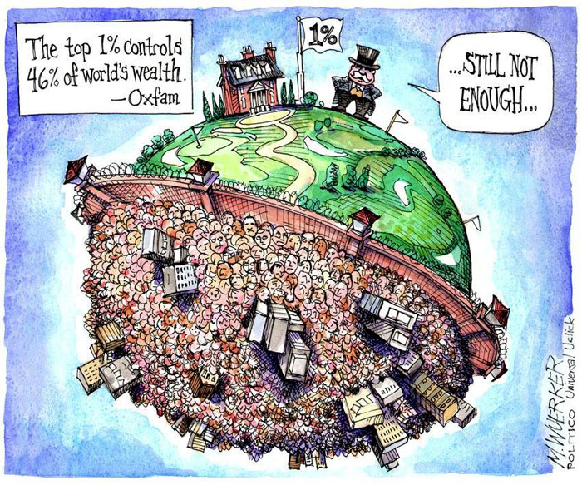
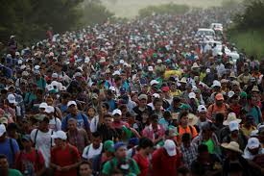
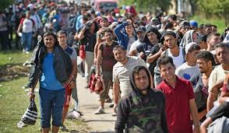
The world is changing
Notes:
Many unresolved global problems - food security, wealth distribution, environmental crises, refugee crises, coronavirus
Increasing nationalism, populism and anti-globalism
A desire to go back to the ‘glory days’ of the past.
Persistent and growing inequality
All highlight inequality and fragility in our interconnected, world

Slide 5
The role of universities is evolving
The social impact of universities on a global scale is recognised as a key feature of the evolution of higher education
Universities now not only have a responsibility to ensure national prosperity
They also need to contribute to the global common good through the creation of knowledge and its application to improve the lives of people all over the world (Marginson 2016)
And the creation of dynamic and sustainable global communities ‘no less caring for human values than the pursuit of material wealth’ (Escrigas, Sancez, Hall and Tando 2014)

Slide 6
Definitions have evolved
The Internationalisation of Higher Education (1995; 2004, 2015)
Internationalisation of the Curriculum (1995, 2009, 2015)
Internationalisation at Home (2001; 2015)
Comprehensive Internationalisation (2011)
The forms and purpose of IoC must change in order to overcome its elitist roots and become inclusive all students (de Wit & Leask, 2017).

Slide 7
Comprehensive Internationalisation (Hudzik 2011)
Commitment, confirmed through action, not just something we talk about
Will shape institutional ethos and values and actions
Requires the infusion of international and comparative perspectives throughout the teaching, research, and service missions of higher education
In other words it will touch the entire institution
And therefore you cannot achieve CI without internationalising the curriculum

Slide 8
In 2015 the definition of Internationalisation of Higher Education
**Text in bold indicates changes from the previous Knight (2004) definition
The revised definition…Internationalisation of Higher Education is:
'the intentional process of integrating an international, intercultural or global dimension into the purpose, functions and delivery of post-secondary education, in order to enhance the quality of education and research for all students and staff, and to make a meaningful contribution to society.‘ (de Wit et al 2015, p.281)

Slide 9
Internationalisation of the Curriculum Revised
Internationalisation at Home
“…the purposeful integration of international and intercultural dimensions into the formal and informal curriculum for all students within domestic learning environments” (Beelen & Jones, 2015)
“The incorporation of international, intercultural and/or global dimensions into the content of the curriculum as well as the learning outcomes, assessment tasks, teaching methods and support services of a program of study”
(Leask 2015)
What students will know
What they will be able to do
And who they will be
Across the three domains of curriculum – ‘knowing, doing and being’
(Barnett and Coate 2005)

Slide 10
In summary, why do we need to reimagine the curriculum?
The world has changed/is changing as a result of social, political, environmental and economic forces.
Role of higher education institutions has evolved to include a stronger focus on global social responsibility, and how the ‘local’ relates to the ‘global’.
Internationalisation of student learning has too often been inequitable and too narrowly focused – also irresponsible?
Time to focus internationalizing the learning of all students at home in ways that are sustainable and appopriate for the local program/community.

Slide 11
How do we reimagine IoC?
How can we achieve more equitable, responsible, and sustainable approaches to IoC that are consistent with the changing context of HE institutions and updated definitions of key concepts related to the internationalisation of higher education ?

Slide 12
We need to think differently about curriculum and IoC
Syllabus – content, teaching methodology,
learning & assessment activities
Formal
Curriculum
Hidden
Curriculum
Informal
Curriculum
… and move it from optional activities, to a core, integrated mission-driven strategy, enabled by public policy and institutional mission and strategy.
Extra-curricular activities and experiences
Unintended, hidden messages
b.leask@Latrobe.edu.au
www.ioc.global
Notes:
It is important at an institutional and a program level to consider how the informal curriculum, or co-curriculum, supports the work of the formal curriculum. It’s also important to consider the hidden curriculum because of the focus on the intercultural as a critical element of an internationalized curriculum. Culture is values based, and values are often communicated unconsciously.

Slide 13
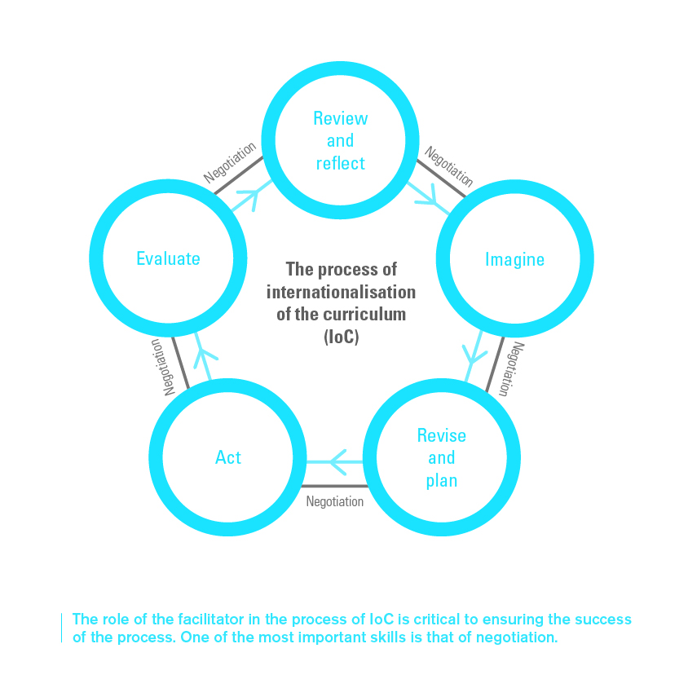
It’s important to approach Internationalisation of the formal curriculum as a process of critical course and program review in context – of which negotiation is an important component.
Leask. B. (2015). Internationalizing the Curriculum. Routledge, Abingdon. p. 42
.
b.leask@Latrobe.edu.au
www.ioc.global
Notes:
REFER THEM TO THE IOC BROCHURE AND THE QUESTIONS ON THE LAST PAGE RELATED TO EACH STAGE OF THE PROCESS
Evolution not revolution
Continuous improvement
A cyclical and evolutionary process
Core work done by academic staff in disciplinary teams
Value in outside expertise too
Short-term goals and incentives

Slide 14
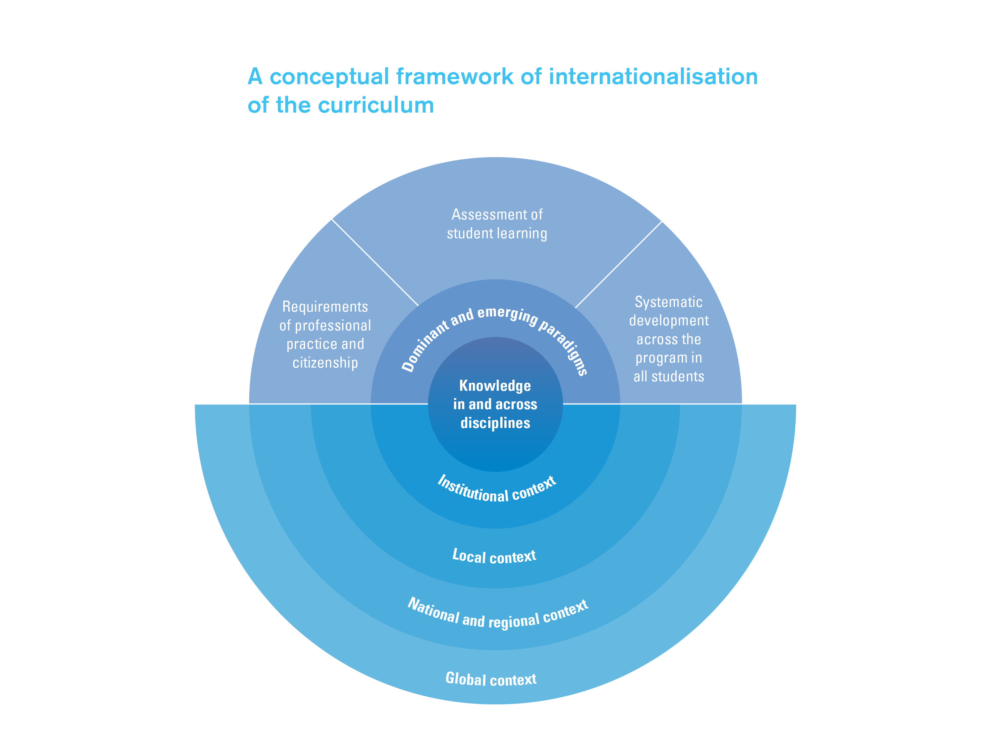
A primary concern of faculty/academic staff
Curriculum design
Contextual influences
Betty Leask
b.leask@latrobe.edu.au
www.ioc.global
Notes:
The Global context: What kind of world do we live in? What kind of world do we want?
National and regional context: What culture of HE internationalisation, past, present, future?
Institutional context: What mission, ethos, policies and priorities?

Slide 15
IoC is a critical component of the internationalisation of the University
1.
Rationale & strategy for internationalisation
10.
Monitoring, reflection, evaluation & review
2.
Governance, leadership & management
3.
Internationalisation of informal curriculum & campus culture
9.
Resources follow strategy
Globally competent graduates
8.
Broad and deep international partnerships
4. Internationalisation of formal curriculum – all students
7.
Staff development, recognition & reward – all staff
6.
Guidance and support for students outside the classroom
5.
Student diversity
From: Jones, E. (2013) The Global Reach of Universities: leading and engaging academic and support staff in the internationalisation of higher education. In Sugden, R., Valania, M. & Wilson, J.R. (Eds) Leadership and Cooperation in Academia: Reflecting on the Roles and Responsibilities of University Faculty and Management. Cheltenham: Edward Elgar.
1
1
3
8
4
6
5

Slide 16
Challenges
Creating and communicating the internationalisation vision – for institution, program/course/subject, staff, students, community
Developing and communicating the stategy – e.g.
Global Learning for All OR Globally Competent Graduates
Graduate attributes – “all students will graduate with international and intercultural perspectives’’
Sustainable Development Goals
Leadership – strong leadership from the top with space for program-specific interpretation (distributed leadership)
Personal and professional biases as educators/professionals.

Slide 17
Conclusion

Slide 18
In summary, we need to think differently about curriculum and internationalisation,
Key focus areas:
The curriculum as more than the syllabus.
IoC beyond mobility.
All students learning in context of discipline and program, with a particular purpose related to international, intercultural, global dimensions of professional and personal life
IoC as a dynamic, complex and ongoing process
Distributing leadership and responsibility across the entire university, coordinating action and monitoring impact on all students’ learning

Slide 19
References
Beelen J., Jones E. (2015) Redefining Internationalization at Home. In: Curaj A., Matei L., Pricopie R., Salmi J., Scott P. (eds) The European Higher Education Area. Springer, Cham. https://doi.org/10.1007/978-3-319-20877-0_5
Crowther, P, Joris, M, Otten, M, Nilsson, B, Teekens, H & Wächter, B. (2001) Internationalisation at home: A position paper, EAIE, Amsterdam.
Jones, E. (2013). The Global Reach of Universities: Leading and engaging academic and support staff in the internationalization of higher education. In R. Sugden & M.Valania & J. R. Wilson (eds.), Leadership and Cooperation in Academia, (pp. 161-183). Edward Elgar Publishing.
Leask, B. (2015) Internationalising the Curriculum. Routledge

