Slide 1
New mastercourse Delta Development
Start: September 2018; pilotgroup February 2018
Cooperation 3 universities of applied sciences: HZ, HR (Rotterdam) and VHL (Velp, near Arnhem): Joint degree
90 EC (1 ½ years)
Master of science (MSc)
In English

Slide 2
Profile mastercourse
To get profound knowledge of the Delta watersystem by working 1 ½ years in the different parts and subsystems of the Delta (coast, river and city)
To work with the newest insights and methods in Delta technology, design and governance by joining the researchprogrammes of the 3 universities of applied sciences
To have innovative teachingmethods (blendid learning) and a thorough competenceprofile, with reviews by Deltaprofessionals, researchers and lecturers
To obtain 21st century skills, to be prepared for tomorrows society. To shape the future work field and society

Slide 3
Expertise participating universities
Rotterdam
Transition to a sustainable port
Pillars: planning and urbanism, infrastructure and mobility, watermanagement
Vlissingen
Transition to a safe, resilient and economically viable Delta
Pillars: watertechnology, building with nature, aquaculture, deltamanagement
Velp
Transition to a sustainable riversystem
Pillars: dealing with risks, governance, multilayersafety, dykes
Together they cover the whole range of problems in Delta areas and coastal zones

Slide 4
Competences
Central theme:
Transitions of delta’s: from large scale control to a sustainable agile approach
3 types of competences
Transition-competences dealing with complexity and uncertainty, systemthinking, innovative capacity, cooperation in transdisciplinary teams
Knowledge competences: knowledge of deltasystems
Competences of the projectcycle problemdefinition, design, realisation, monitoring/maintenance

Slide 5
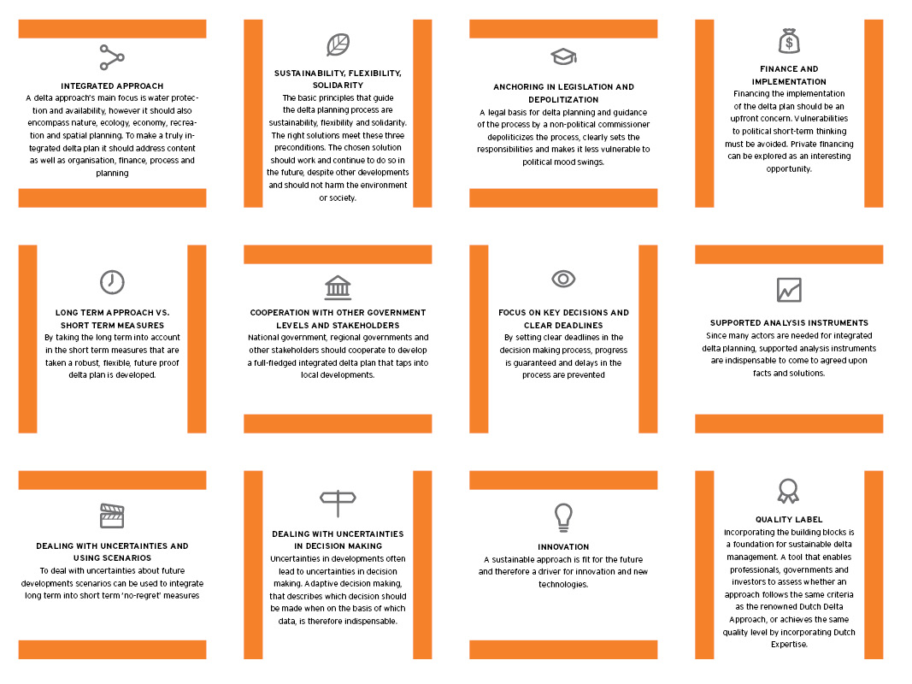
Framework: Delta Approach

Slide 6
Living labs
As a form of international education, research & collaboration
a living lab is a research environment, often operating in a
territorial context (e.g. city, agglomeration, region), in which research and innovation take place simultaneously, based on the principles of co-creation and participatory design. Students, companies, governments, designers, researchers and users innovate together
(quadruple helix).

Slide 7
Living labs
Characteristics of working and learning in a living lab
Werkt vanuit een maatschappelijke vraag- of doelstelling;
Zorgt voor participatie en adequate, breed gedragen vraagarticulatie;
Is een plaats waar groepsleren, co-creatie, innoveren, valoriseren met stakeholders en studenten plaatsvindt;
Zorgt voor het verbinden van onderzoek met het curriculum, het beroepenveld en de maatschappij;
Is multi- of interdisciplinair van opzet;
Wordt naast projectfinanciering ook mogelijk gemaakt door benutting van eerste geldstromen uit het onderwijs;
Is een vorm waarin de HZ aan maatschappelijke vernieuwing doet;
Biedt garantie voor langjarige verankering van samenwerkingen;
Biedt verdieping én verbreding bij het opleiden van de T-shape professional.

Slide 8
Examples of living labs
Merwe- en Vierhavens in Rotterdam
Zelfredzaamheid eiland Dordrecht (meerlaagse veiligheid)
Science in Residence Veere
Innovatiezone Westvoorne
Resilience Surabaya
Transboundary Rhine River
Better Wetter (NO-Friesland)

Slide 9
Moving along in the Delta area
Students stay half a year at each of the three universities and obtain a joint degree
Competences and approach make the coherence and connection between the three places
Two startingmoments each year: February and September

Slide 10
Which students?
Students following a BA (90 EC)
HBO Bachelorstudents van HR, VHL en HZ
Students from other HBO en WO bachelorstudies
Students from abroad
Professionals (60 EC)
In 2 years
with a minimum of 3 years relevant workexperience

Slide 11
Unique
Extremely relevant, topical and worldwide issues
Cooperation 3 universities of applied sciences
Education and research with researchgroups in
living labs
After completion of the study: graduates contribute to the sustainabe transition of Delta areas and they will be ambassadors of the (Dutch) watersector!

