Slide 1
Engaging Masters students in research and inquiry in the professions: International perspectives
Mick Healey
www.mickhealey.co.uk
“research and enquiry is a key differentiator at master's level”
QAA (2013)
“Recognising work at Master's level is one of those "I can't describe it, but I know it when I see it" situations”
Atherton (2013)
Notes:
1
Phrase comes from US Supreme Court Justice on the definition of obscenity 1964

Slide 2
Engaging Masters’ students in research & inquiry
One minute each way
In pairs you each have ONE minute to tell your partner about one experience you have of engaging Masters’ students in research & inquiry
The job of your partner is to listen enthusiastically but NOT interrupt.
Notes:
2
7
3

Slide 3
Brief biography
HE Consultant and Researcher; Emeritus Professor University of Gloucestershire (UoG), UK; Visiting Professor University College London, UK; The Humboldt Distinguished Scholar in Research-Based Learning McMaster University, Canada; Adjunct Professor Macquarie University, Australia; International Teaching Fellow, University College Cork, Ireland; Visiting Fellow University of Queensland, Australia
National Teaching Fellow; Principal Fellow HE Academy; SEDA@20 Legacy Award for Disciplinary Development; International Society for Scholarship of Teaching and Learning (ISSoTL) Distinguished Service Award
Economic geographer and previously Director Centre for Active Learning UoG
Advisor to Canadian Federal Government ‘Roundtable on Research, Teaching and Learning in post-Secondary Education’ (2006)
Advisor to Australian Learning and Teaching Council / Office of Learning and Teaching Projects / Fellowships on the ‘Teaching-research nexus’ (2006-08), ‘Undergraduate research’ (2009-10); ‘Teaching research’ (2011-13 ); and ‘Capstone curriculum across disciplines’ (2013-15); Students as Partners (2015-16)
Advisor to League of European Research Universities (2009)
Advisor to EU Bologna and HE Reform Experts on research-based education (2012)
Research interests: linking research and teaching; scholarship of teaching; active learning; developing an inclusive curriculum; students as change agents and as partners
Notes:
3
3

Slide 4
  “All Masters students in Hogeschools should experience learning through, and about, research and inquiry.”
Strongly agree
Strongly disagree
Notes:
Mick

Slide 5
“To enhance the quality of learning in Hogeschools it is more important to focus on engaging students in research and inquiry than raising the research expertise of staff.”
Strongly agree
Strongly disagree
Notes:
Mick

Slide 6
Research & inquiry
Mastersness
Professional Learning

Slide 7
Engaging Masters’ students in research and inquiry
Facets of Masterness
Different ways of engaging students in research and inquiry
Rethinking Masters Capstone Projects and Dissertations
Notes:
7
7
3

Slide 8
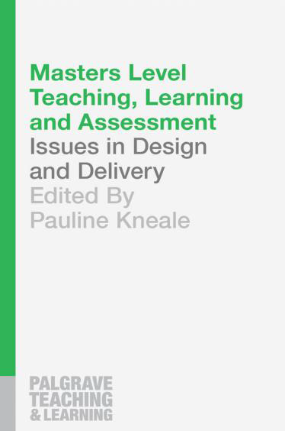
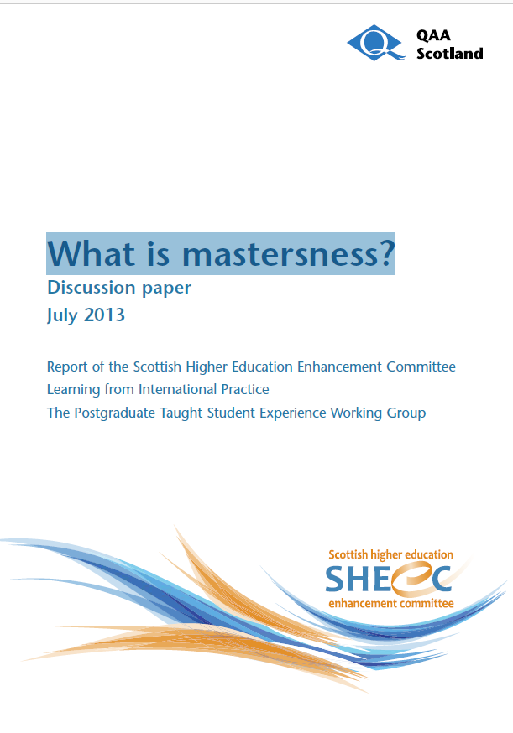
What is M-level?
Notes:
8

Slide 9
Source: QAA (2013)
Notes:
9
7
3

Slide 10
Facets of Mastersness: Research
“Regardless of the discipline, mastersness can be considered identifiable by the scale, intensity and complexity of research … The master's-level student population uses a much wider span of research techniques and methods. Students also have greater control over the actual research, being involved in defining and planning the work.” (QAA 2013a, 5)
Notes:
10

Slide 11
Facets of Mastersness: Professionalism
“… master's-level study involves 'becoming' part of a community or culture, whether in academe or in other professions. Master's students are on the cusp of the line of becoming peers rather than being students. They take on more responsibility. … Context is key and this involves getting the students to identify the characteristics of their professional context - actively embracing values, ethics and accountability - and work within it.” (QAA 2013a, 7)
Notes:
7
3

Slide 12
Masterness: Research into practice
In pairs, each skim read at least
ONE different case study (1.1 – 1.5 pp 3-5).
Discuss whether and how any of the ideas may be amended for application in your contexts.
5 minutes

Slide 13
Mastersness: Some challenges for practice
How can the students' different background experiences be taken into account?
How to demystify the term 'research' to take account of the different kinds of research in different Master's programmes?
Master's students are often quite expert in their own professional field but novices when it comes to academic study - how to balance the theory/practice gap?
QAA (2013a, 4, 7, 9)
Notes:
7
3

Slide 14
Our argument: a ‘research active curriculum’
“All … students in all higher education institutions should experience learning through, and about, research and inquiry. … We argue, as does much recent US experience, that such curricular experience should and can be mainstreamed for all or many students through a research-active curriculum. We argue that this can be achieved through structured interventions at course team, departmental, institutional and national levels” (Healey and Jenkins, 2009, 3).

Slide 15
Students as partners in professional and community learning, research and inquiry
Table 1: Learning configurations
Form | Linkages between | Titles
Duos | Research and Education | Research-based education (RBE); Research-based learning (RBL)
 | Work and Education | Work integrated learning (WIL); Work-based learning (WBL)
 | Community and Education | Community-based learning (WBL)
Trios | Research, Work and Education | Professional Learning Environments (PLEs)
 | Research, Community and Education | Community Learning Environments (CLEs)
Quads | Research, Work, Community and Education | Professional and Community Learning Environments (PCLEs)
Notes:
15
7
3

Slide 16
STUDENTS ARE PARTICIPANTS
Research-tutored
Research-based
Engaging in research discussions
Undertaking research and inquiry
EMPHASIS ON RESEARCH PROCESSES AND PROBLEMS
EMPHASIS ON RESEARCH CONTENT
Learning about current research in the discipline
Developing research and inquiry skills and techniques
Research-led
Research-oriented
STUDENTS FREQUENTLY ARE AN AUDIENCE
Curriculum design and the research-teaching nexus
(based on Healey, 2005, 70)
Notes:
16

Slide 17
STUDENT-LED
Pursuing
(information-active)
Authoring
(discovery-active)
EXPLORING AND ACQUIRING EXISTING KNOWLEDGE
PARTICIPATING IN BUILDING KNOWLEDGE
Identifying
(information-responsive)
Producing
(discovery-responsive)
STAFF-LED
Inquiry-based learning: a conceptual framework (based on Levy, 2009, 2011)

Slide 18
The language of end of programme research projects
Dissertations
End of programme projects
Capstone projects

Slide 19
Dissertations
In the UK a ‘dissertation’ normally refers to an end of programme research project.
The majority of undergraduates undertake an dissertation for their Bachelor honours degree and a dissertation for a Masters Degree.
Traditionally it is a single authored, 8-20,000 word piece of work

Slide 20
Capstone projects
Capstone project – term commonly used in North America and Australasia to refer to integrative final year projects
Notes:
20

Slide 21
Rethinking the traditional dissertation
To be wider in their:
conception (e.g. collaborative projects as part of a research group; consultancy projects);
function (e.g. synthesising capstone projects; preparatory projects for transition into a profession);
form (e.g. student group projects);
location (e.g. employer and community based projects); and/or
how they are disseminated and assessed (e.g. through exhibitions, research conferences and other forms of public engagement)
Notes:
21

Slide 22
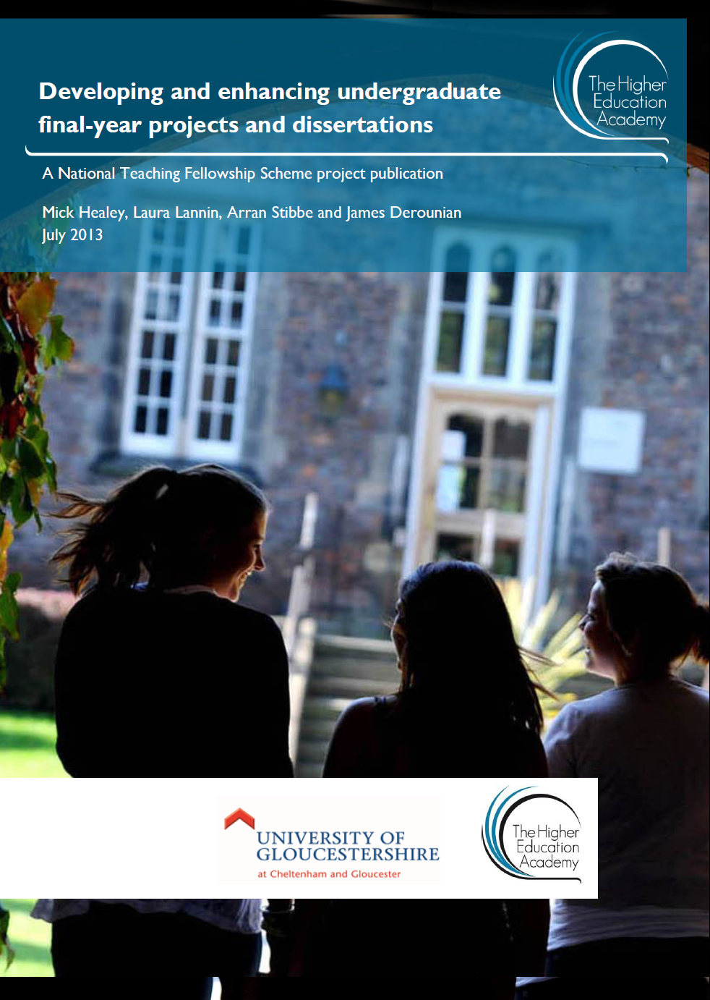
“Our argument is that a more flexible but equally robust approach is required to the design and assessment of FYPD [final year projects and dissertations] to meet the needs of students from diverse subject areas and types of institution.” (Healey et al., 2013: 10)
Notes:
22

Slide 23
Alternatives to traditional dissertations
Case studies
Arts, Design, Media and Humanities
Business, Hospitality, Law, Sport and Tourism
Interdisciplinary
Education, Social and Environmental Sciences
Science, Technology, Engineering and Mathematics
Notes:
23

Slide 24
Alternatives to traditional dissertations
In groups of 3-4s each of you should look at least one different mini-case study from groups 1-3 (pp5-11) and identify interesting practices which you can then share with others in your group.
Be ready to report back on ONE interesting idea from your group
Time: 8 minutes
Notes:
24

Slide 25
Alternatives to traditional dissertations
In groups of 3-4s each of you should look at least one different mini-case study from groups 3-5 (pp9-16 and identify interesting practices which you then share with others in your group.
Be ready to report back on ONE interesting idea from your group
Time: 8 minutes
Notes:
25

Slide 26
“I cannot think of anything more unfair than … to treat all students as if they are the same, when they so manifestly are not” (Elton 2000: 1).
Notes:
Inclusivity involves recognising difference, providing flexibility and choice not uniformity and treating everyone identically.

Slide 27
Anticipated challenge areas
Each table should come up with an outstanding question concerning engaging Masters’ students in research and inquiry which you would like help with.
  Keep the question short and simple
5 minutes

Slide 28
Break out activity
Identify one key strategy for answering the question that you have received.
5 minutes

Slide 29
Engaging students in research and inquiry
In threes and fours one of you should identify a way in which you propose to engage the Masters students in your course in research and inquiry and the others should act as critical friends.
Notes:
29

Slide 30
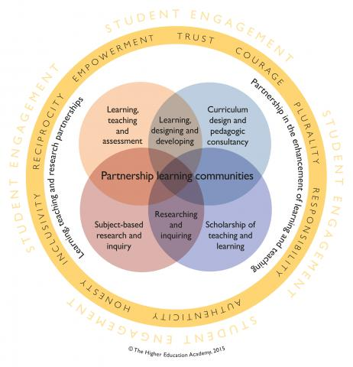
Students as partners in learning and teaching in higher education
Source: Based on Healey, Flint and Harrington (2014, 25)
Notes:
30
At the centre of the model is the development of partnership learning communities. If partnership only occurs in pockets of distinct initiatives or modules it is unlikely to reach its full potential in terms of impacts so community is crucial to the embedding and sustaining of partnership as an ethos and aspect of institutional culture.
Why community is important
We know, from the synthesis of evidence from the what works programme that encouraging a sense of belonging and community can lead to increased student retention and success. What works? - “the academic sphere is the most important for nurturing participation of the type which engenders a sense of belonging” (Thomas 2012)
Many evidenced features of student engagement that have a direct relationship with ideas of community.
- encouraging reciprocity and co-operation amongst students, interactions between staff and students, respect for diversity, and a university environment that makes students feel supported and legitimated (Chickering and Gamson 1987, Kuh 2001, Coates 2007)
If we understand partnership to be both a learning and working relationship – literature suggests lots of critical success factors.
Some of these are easier to build in to policies, processes and structures – e.g. working arrangements like having shared goals, joint decision-making, dispersal of power, sharing knowledge and practices – can build these in to things like institutional partnership agreements.
Others are more about values and attitudes – harder to build into formal documents and structures – things like respect, trust, reciprocity, responsibility, listening, recognition and valuing of difference, open and honest communication – these are more about a culture and ethos – how people relate to one-another. Fostering the development of communities among staff and students is one way we can try and embed/sustain a culture of partnership.
Taken together a partnership learning community is encouraged by structures and working/learning arrangements that support partnership, shared values, and attitudes and behaviours that each member of the community signs up to and embodies in practice.
We’ve drawn on the scholarship of learning communities and communities of practice to develop this idea – but this is more than just inviting students to become partial or temporary members of existing disciplinary, professional or institutional communities – it’s about creating opportunities for new co-created communities to emerge – where all parties are valued fully, and contribute to the development of those communities. These communities acknowledge students and staff as learners, professionals and colleagues – as such they invite us to again think critically about existing relationships, identity, processes and structures – can be truly transformative and where values come to life.

Slide 31

International Journal for Students as Partners (IJSaP)
Research articles, case studies, opinion pieces, reflective essays and reviews
International editorial team of students and staff from Australia, Canada, UK and US
IJSaP explores new perspectives, practices, and policies regarding how students and staff are working in partnership to enhance learning and teaching in higher education
https://mulpress.mcmaster.ca/ijsap

Slide 32

2nd McMaster Summer Institute: 8-11 May 2017
Where possible pairs of staff and students are invited to participate in either one or two consecutive two-day workshops OR a 3.5 day Writing Retreat
Alternatively teams of 4-6 faculty and students (at least two of each) from an institution(s) can apply to join a 3.5 day ‘Change Institute’.
Facilitated by an international team of experienced staff and students from Australia, Canada, UK and US
https://macblog.mcmaster.ca/summer-institute/

Slide 33
Connecting Higher Education: International Perspectives on Research-based Education for the 21st Century
26-28 June 2017
University College London, Central London, United Kingdom
https://www.ucl.ac.uk/teaching-learning/connected-curriculum/conference
Abstract submission closes 10 Jan 2017
UCL + Adelaide + McMaster
Notes:
33

Slide 34
Engaging students in research and inquiry: Conclusions
Getting students to produce knowledge rather than just consume knowledge is a way to re-link teaching and research
The challenge is to mainstream undergraduate research so that all students may potentially benefit
Adopting a broader definition of undergraduate research than is currently common is a way forward (Boyer et al.), which should benefit the learning of students in institutions with a range of different missions
Notes:
34

Slide 35
Engaging students in research and inquiry: Conclusions
If students are to be truly integrated into HE then the nature of higher education will need to be reconceptualised.
  “universities need to move towards creating inclusive scholarly knowledge-building communities. … The notion of inclusive scholarly knowledge-building communities invites us to consider new ideas about who the scholars are in universities and how they might work in partnership.” (Brew, 2007, 4)
There is a need to do more thinking ‘outside the box’
Notes:
35

